Slide 1
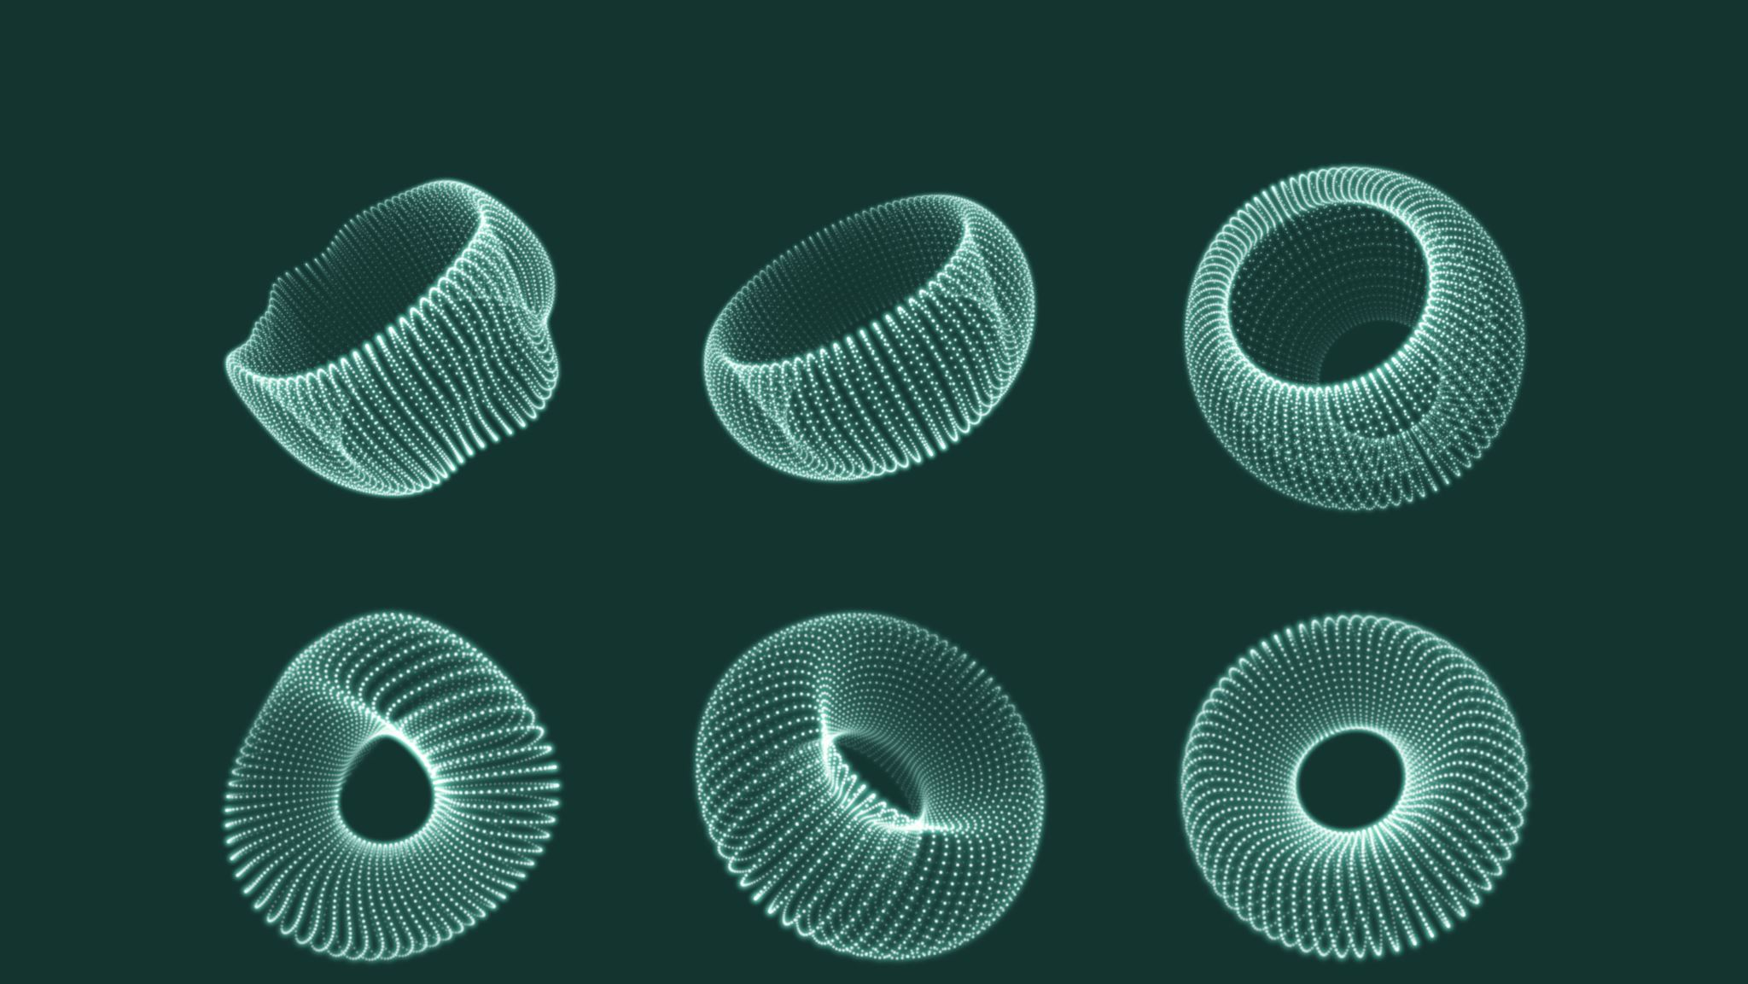
Checking discretization 1by1
By: Kurt Soncco, PhD

Slide 2
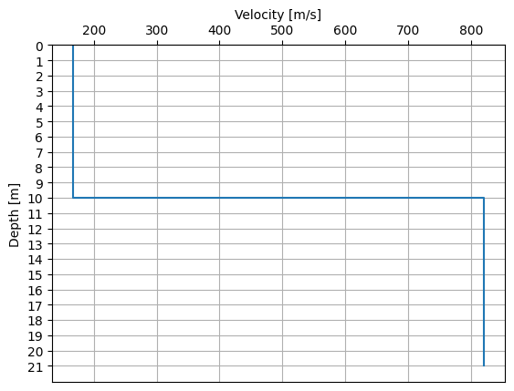
Why are we no seeing the reflections in shallow surfaces?
Base Case:
Vs1 = 166.31 m/s
Vs2 = 821.12 m/s
H = 10 m (Height of soil)
H_Bedrock = 11 m (Height of bedrock)

Slide 3
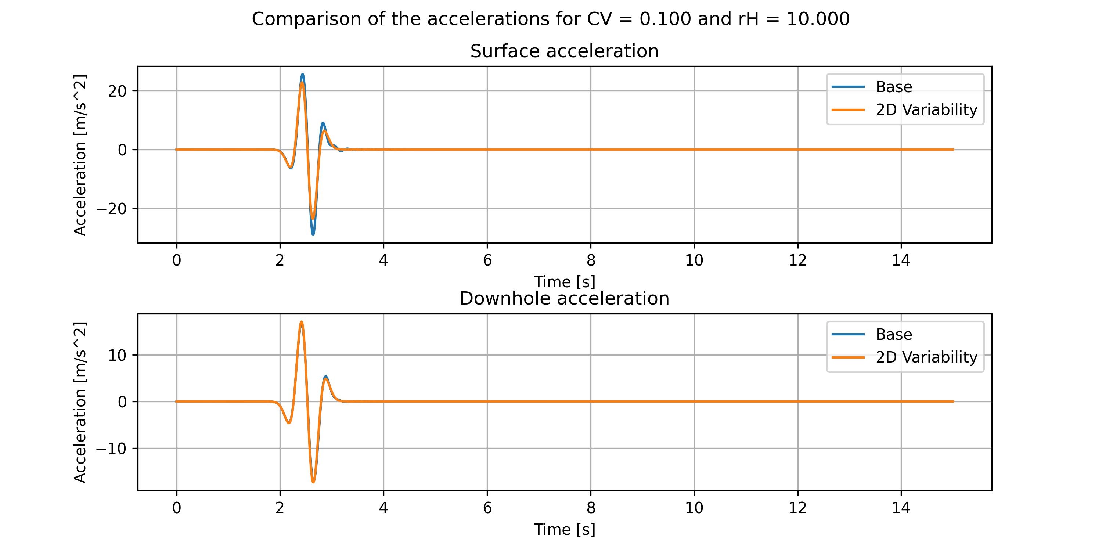
Issue:
Base and Spatial Variable Case does not present any reflections on their accelerograms

Slide 4
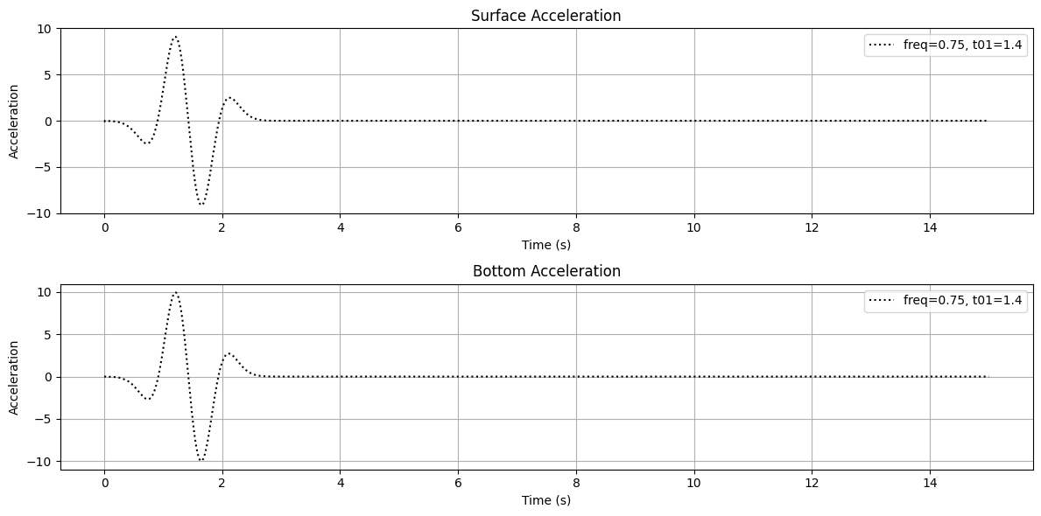
Some references about input wave
Cases proposed in Hallal et al (2023):
Freq01: 0.75
T01: 1.4
The issue:

Slide 5
Some references about input wave
Cases proposed in Hallal et al (2023):
Freq01: 0.75
T01: 1.4
The issue:

Slide 6
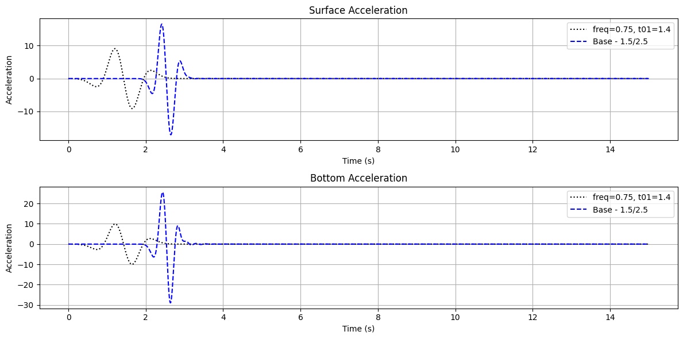

Slide 7
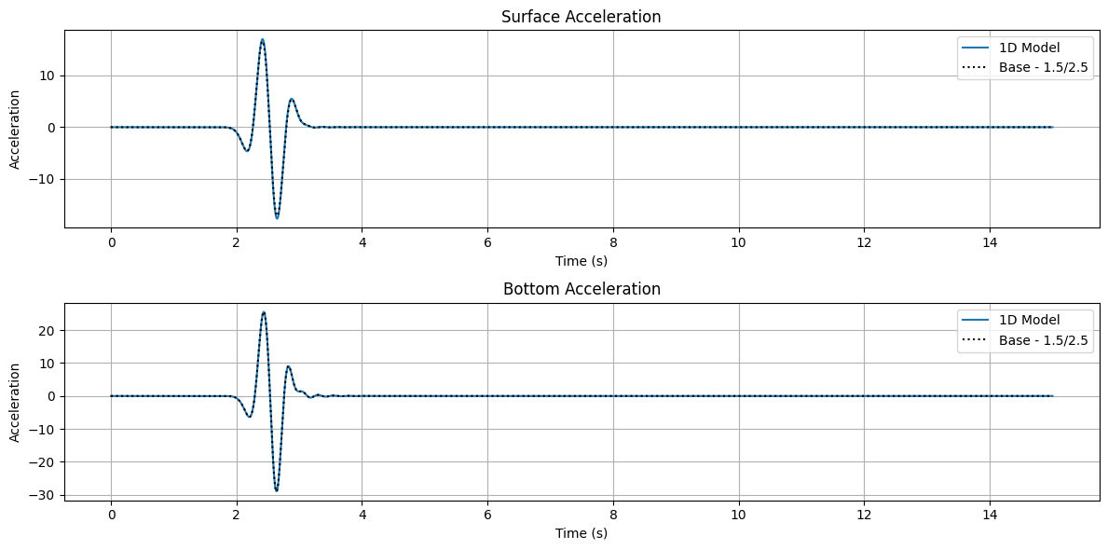
Comparison with Base case

Slide 8
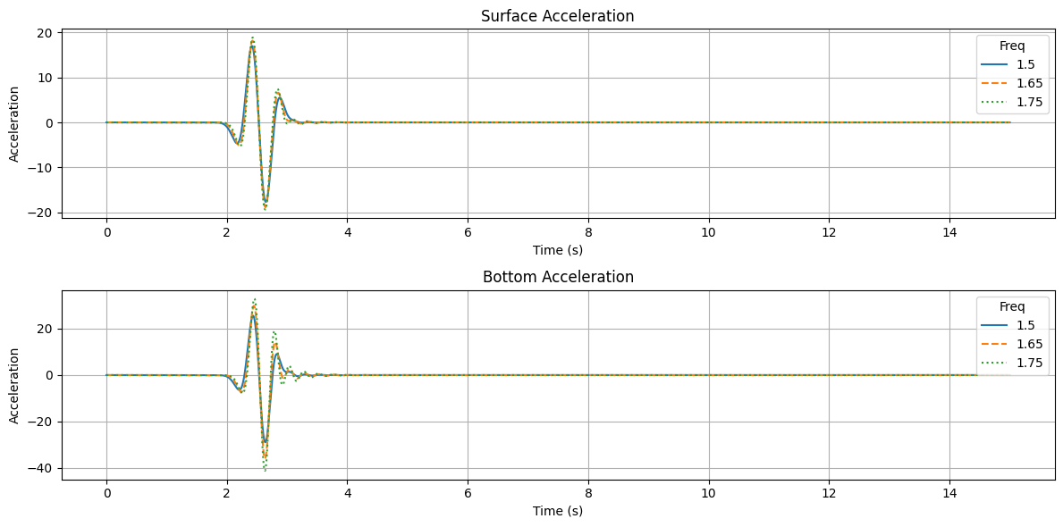
Why are we not seeing reflections?
For a case like this:
Maybe the frequency is important?

Slide 9
Why are we not seeing reflections?
For a case like this:
Maybe the frequency is important?

Slide 11
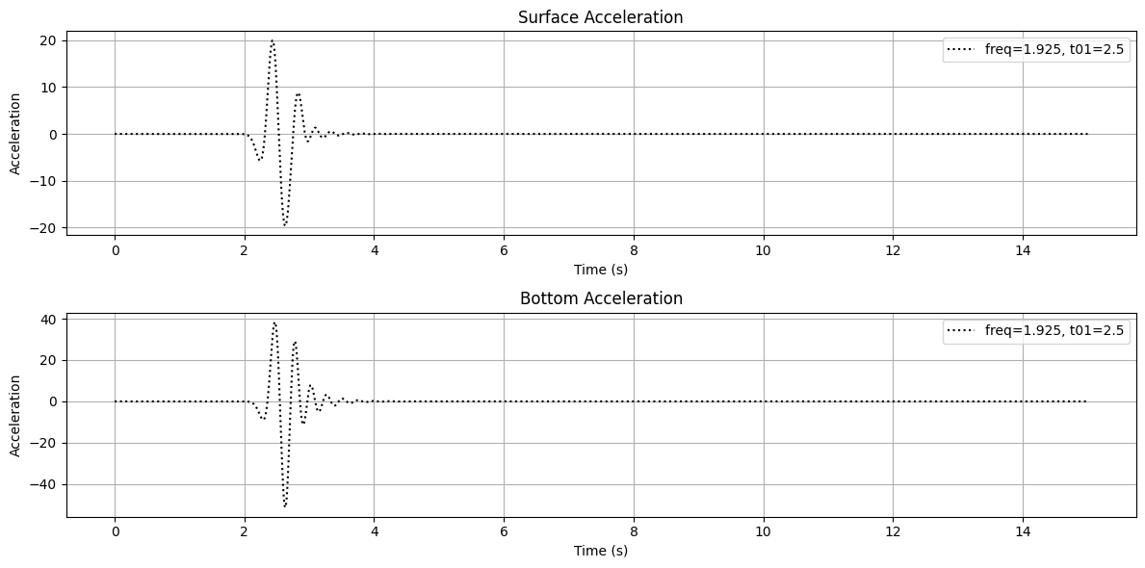

Slide 12


Calculations
Some calculations:
$$f_{0}=\frac{Vs}{4H}=\frac{166.31}{4∗10}=4.16 Hz$$
$$f_{max}=\frac{Vs}{\left[12−15\right]∗1}=\left[13.8−11.0\right]Hz$$

Slide 13
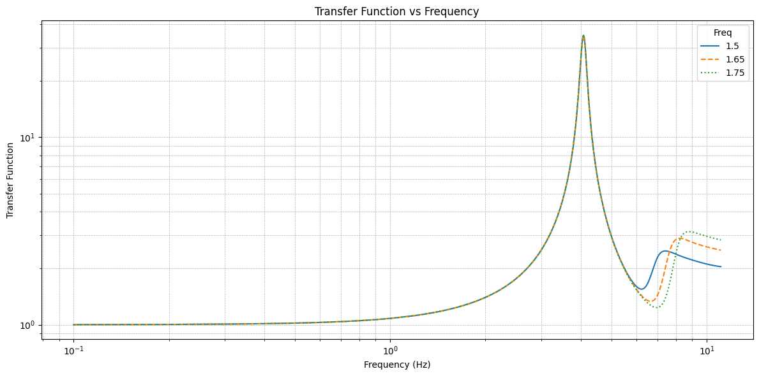
Is the effect seen in the TF?

Slide 14
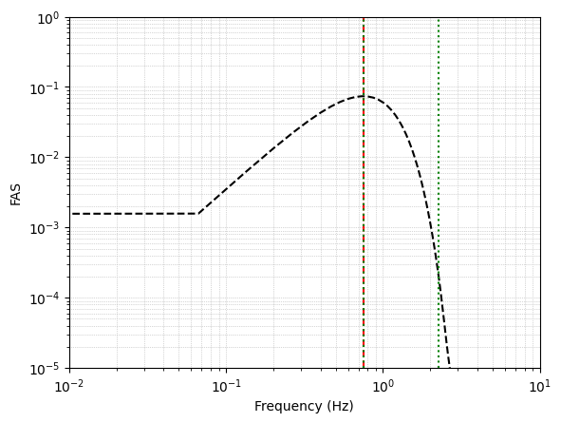
Changing the ricker wave
According to Hallal et al. (2023), the ricker wave they used was centered at the natural frequency of their Case1a.
f_0 = Vs/(4H) = 0.75 Hz [Matching the used ricker wave]

Slide 15
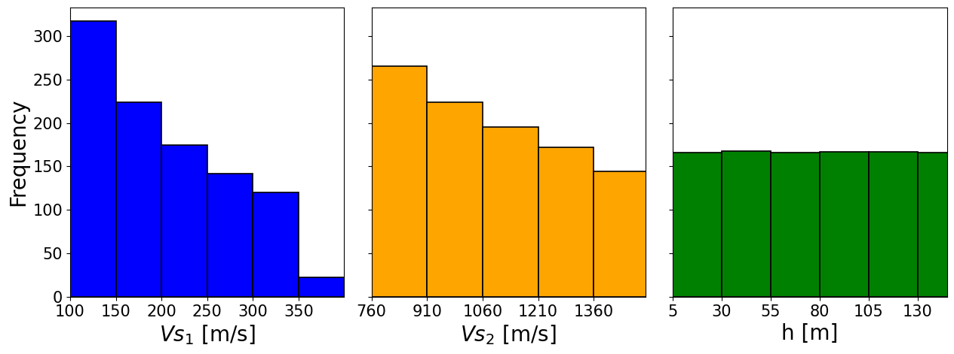
Which frequency to use for the dataset?

Slide 16
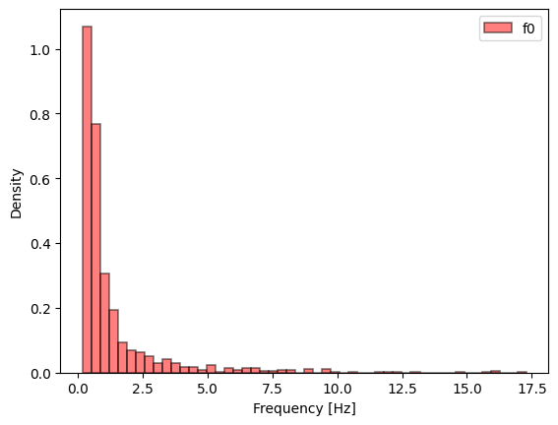
Which frequency to use for the dataset?

Slide 17
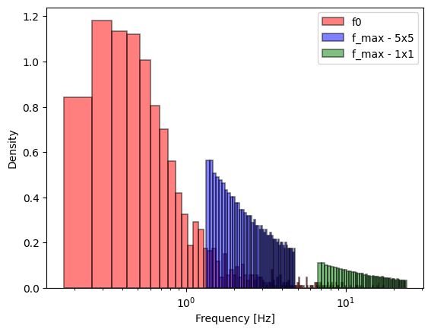
Which frequency to use for the dataset?

Slide 18
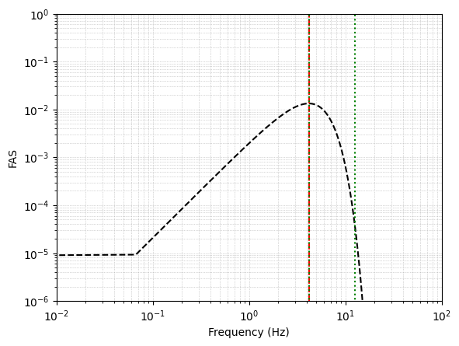

So, for this case:
Vs1 = 166.31 m/s
Vs2 = 821.12 m/s
H = 10 m (Height of soil)
H_Bedrock = 11 m (Height of bedrock)
$$f_{0}=\frac{Vs}{4H}=\frac{166.31}{4∗10}=4.16 Hz$$

Slide 19


Changing the damping:
FLAC needs to calculate the central minimal frequency
0.75% of damping at f_0 and 3*f_0
Based on our calculations:
$α=0.2941;β=0.0001435$
$$ξ_{i}=\frac{1}{2}\left[\frac{α}{ω_{i}}+βω_{i}\right]$$

Slide 20



Changing the damping:
FLAC needs to calculate the central minimal frequency
Given alpha and beta:
Based on our calculations:
$f_{min}=7.205;ξ_{min}=0.006495$
$$f_{min}=\frac{{\left(\frac{α}{β}\right)}^{\frac{1}{2}}}{2π}$$
$$ξ_{min}={\left(α⋅β\right)}^{\frac{1}{2}}$$

Slide 21
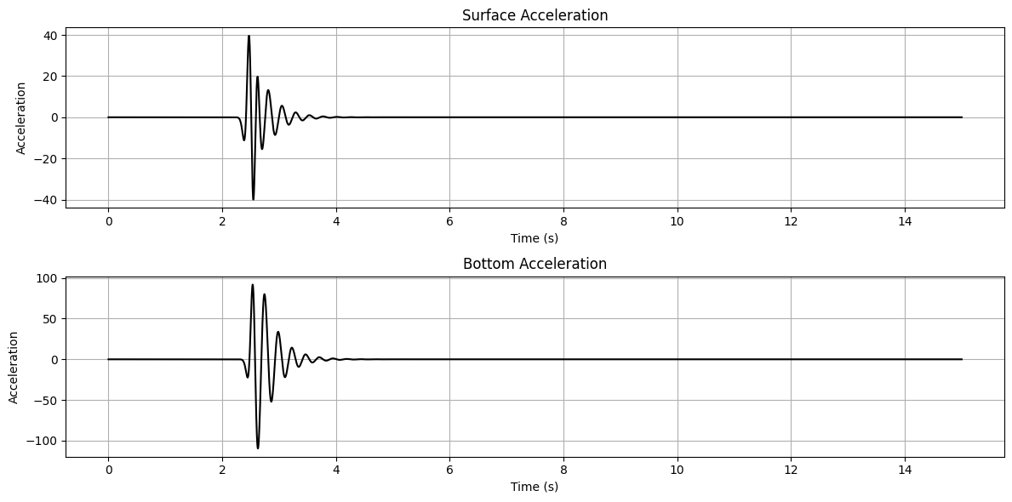
Results

Slide 22
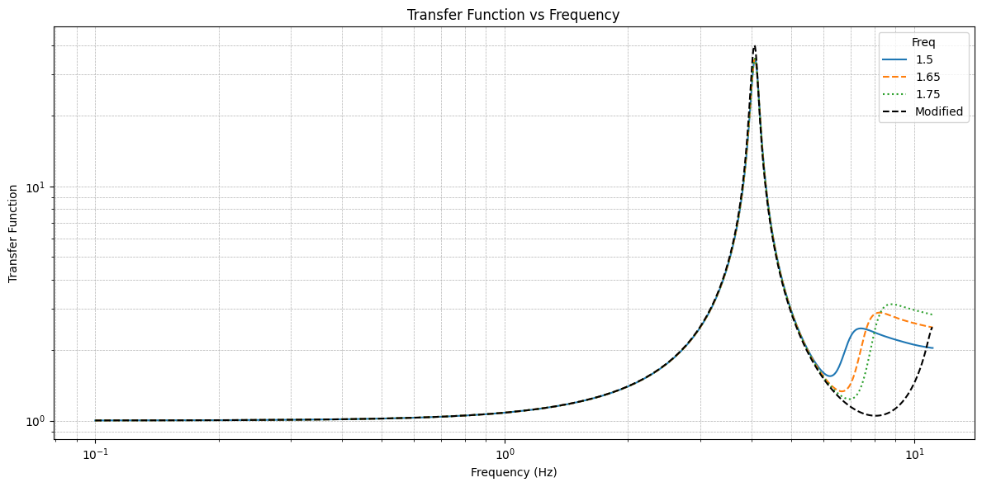
Results

Slide 23
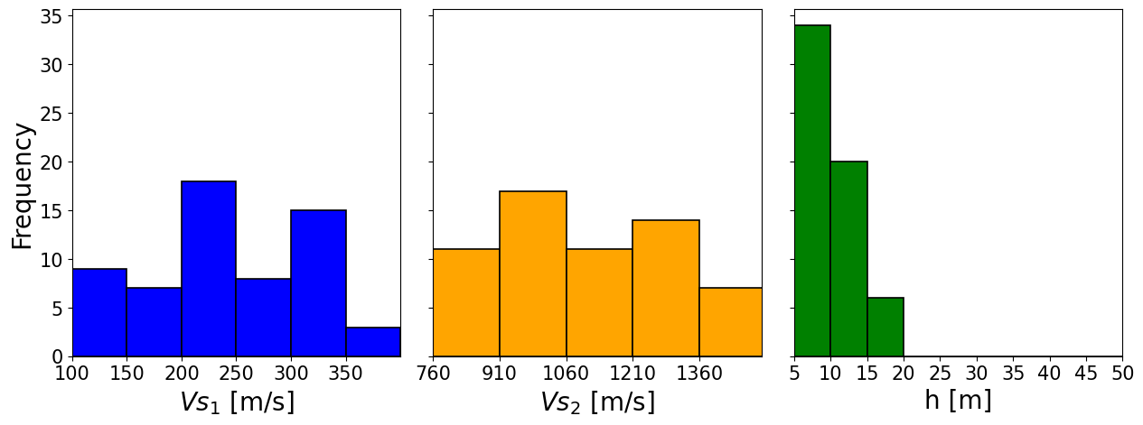
Solution: Check the cases with f0 > 5

Slide 24
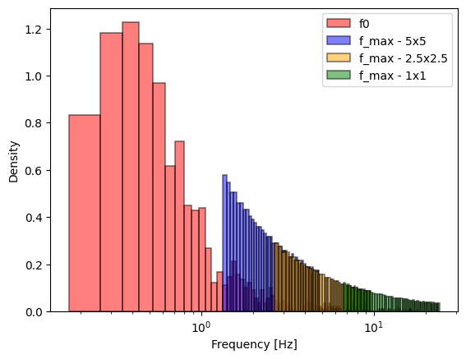
Solution: Check the cases with f0 > 5

